Slide 1

Lithium-Ion Battery Simulator
Mark Veerasingam | G00403931@atu.ie

Slide 2
Project Background
Goal:
Develop a model of a lithium-ion battery based on real-world data.
Develop a software platform that lets users upload battery test data and automatically create a battery model.
Simulation API that run simulations on their battery models.
Dataset:
“Lithium-ion battery aging dataset based on electric vehicle real-driving profiles” – Stanford University

Slide 3
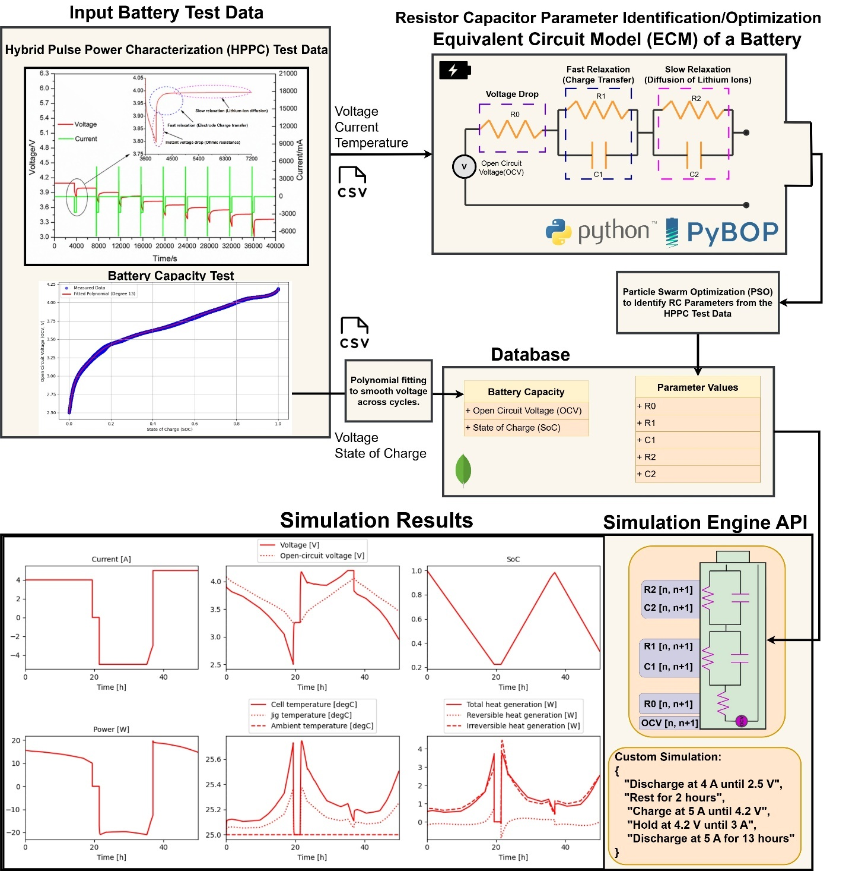

Slide 4
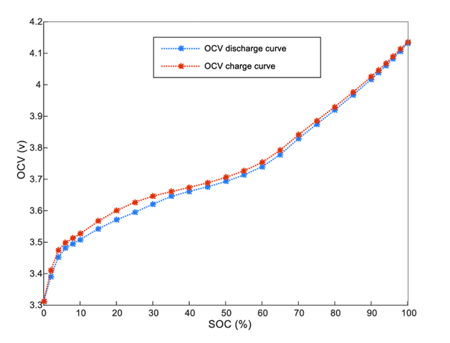
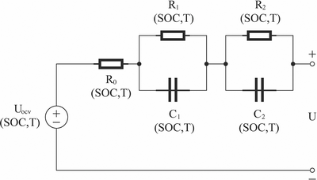
Battery Modelling
Thevenin Equivalent Circuit Models (ECM) represents a battery by using resistors and capacitors to mimic its charging and discharging behavior
Get State Of Charge – Open Circuit Voltage Curve from Capacity Test

Slide 5
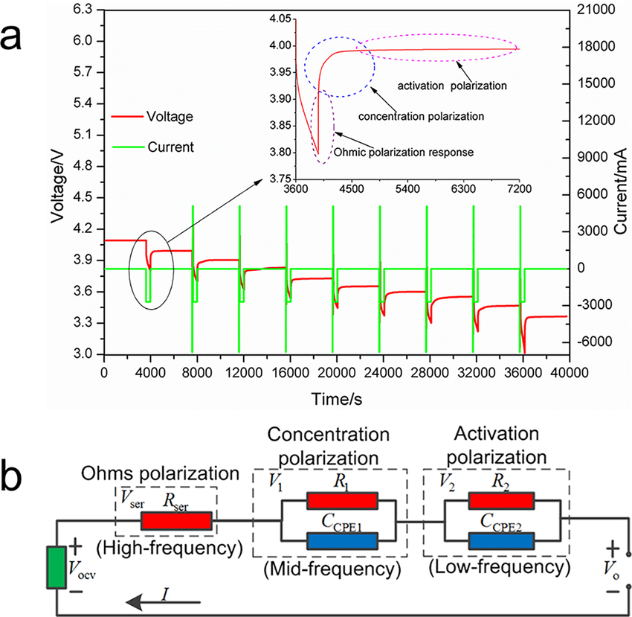
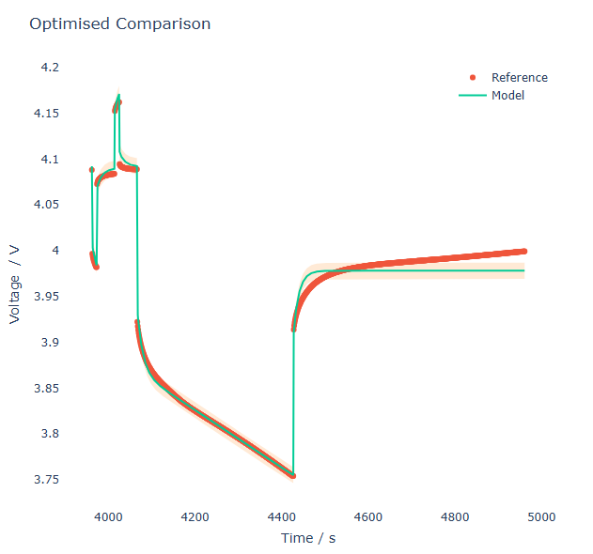
Parameter Optimization
Find RC values with Hybrid Pulse Power Characterization (HPPC) test
Particle Swarm Optimization (PSO) applied to find the RC pair values
Results stored in MongoDB

Slide 6
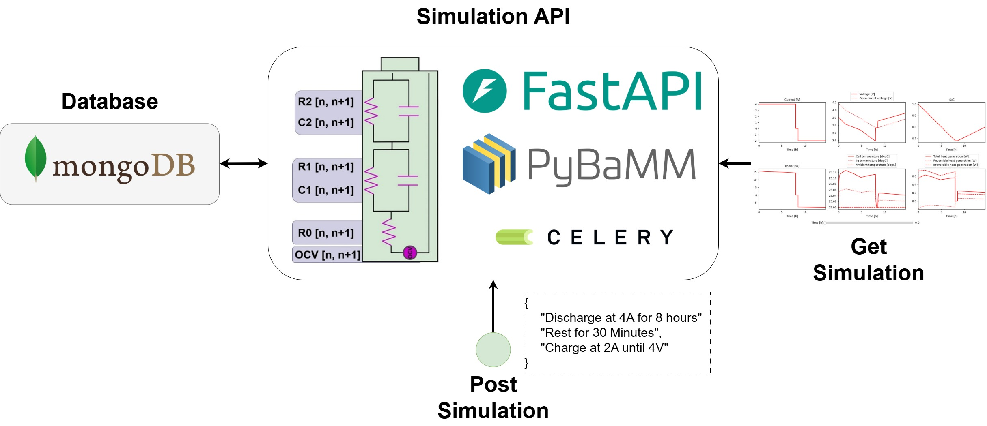
Simulation API

Slide 7
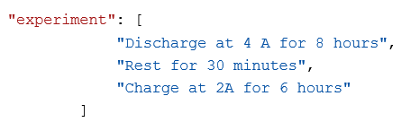
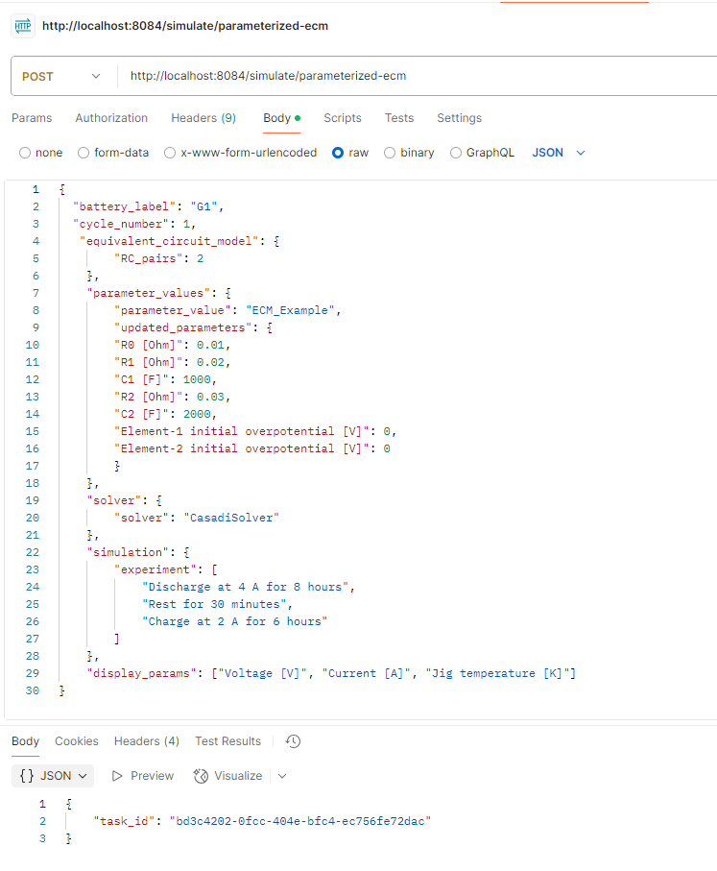
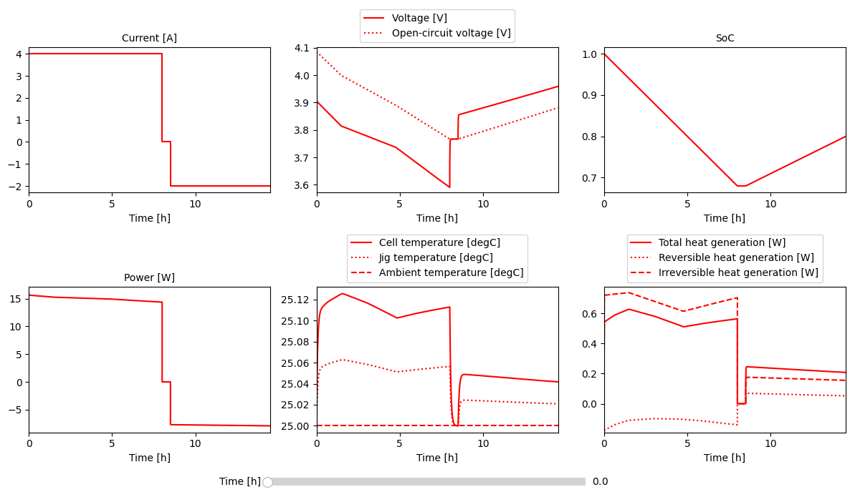
Results

Slide 8


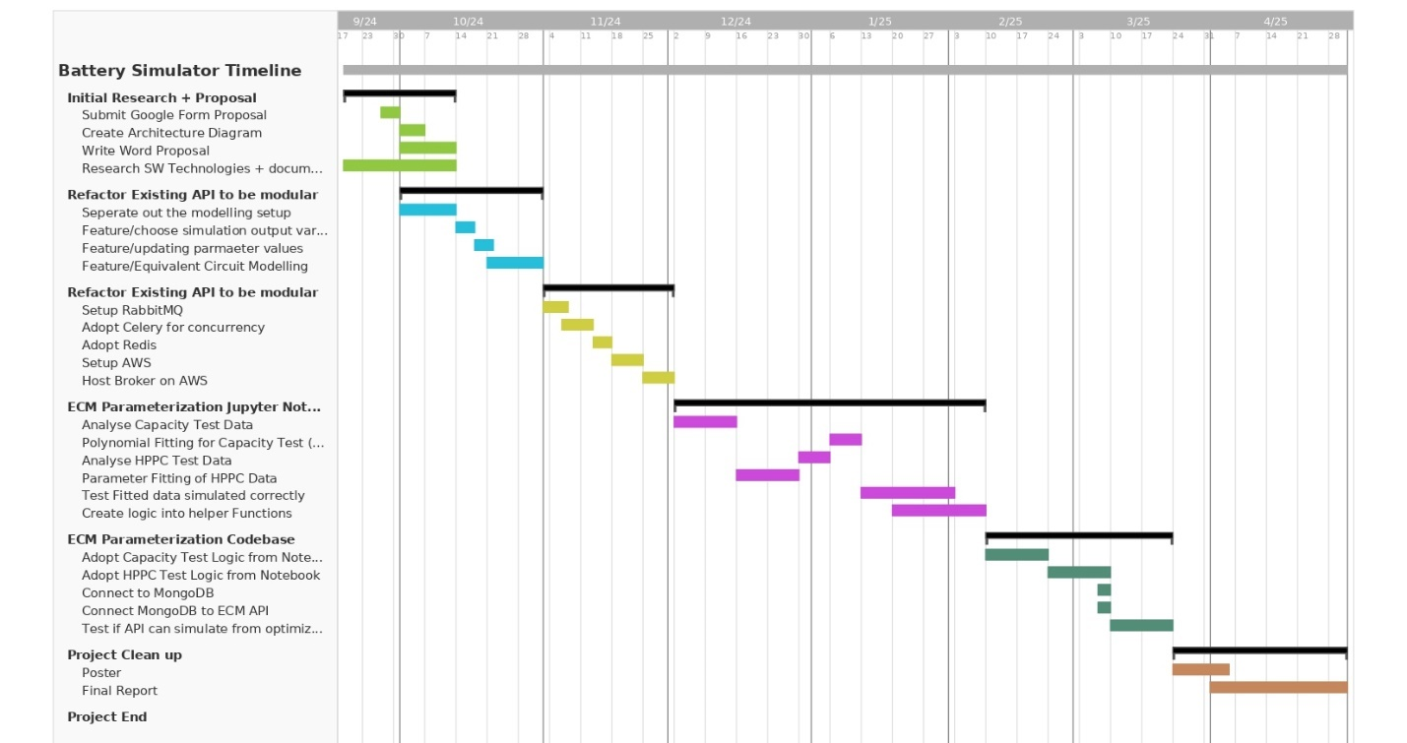
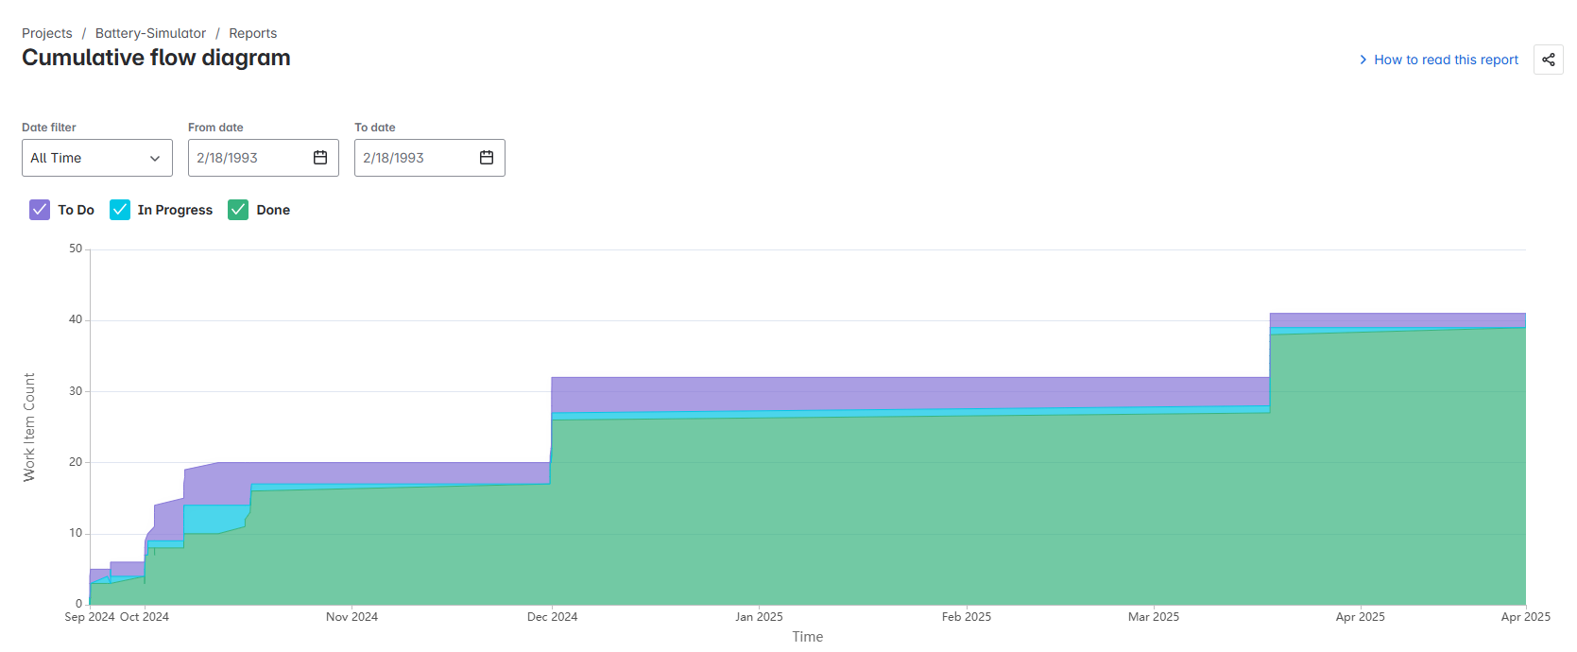
Project Management
Adjusted Timeline
Weekly Logs + Supervisor Meetings

Slide 9
Thanks For Listening

